Slide 1


Go Green, Plant Trees
NurseryKart
BATCH : MARCH 2023
GROUP NUMBER : 13 (PG-DAC)
GUIDE NAME : Mr. Ankit Kumar
GROUP MEMBERS PRN
1) Manish Kumar (230310120013)
2) Ritesh Kaloni (230310120027)
3) Nadeem Ahmed (230310120017)

Slide 2
ABSTRACT
NurseryKart
"NurseryKart" is an innovative online platform designed to revolutionize the way people purchase plants. Through this website, users can conveniently browse and buy a wide variety of plants from the comfort of their homes, offices, and other places . NurseryKart offers a user-friendly interface that showcases an extensive collection of plants, each accompanied by detailed descriptions and images to aid in the selection process. This platform aims to bridge the gap between plant enthusiasts and quality greenery by providing a seamless online shopping experience, With NurseryKart, individuals can effortlessly bring the beauty of nature into their lives, fostering a deeper connection with the environment. It will saves time and energy You don't have to waste your time going to stores, dealing with crowds, and standing in lines.

Slide 3
OBJECTIVE
NurseryKart
To provide a platform for user to explore and purchase plants
To facilitate the user with different categories of plants. Categories as Indoor plants and outdoor plants using e-platform
A platform for Know about plants by Nurserykart blog page.
To provide a user-friendly and accessible interface for Customers.
The ultimate objective is to sell plants , spread the message to customers for benefits of planting and make mother earth green.

Slide 4
MODULES
NurseryKart
NurseryKart is an online platform designed to facilitate selling of plants through the use of digital technologies. The proposed system of an NurseryKart platform should include the following components:
User Interface: The user interface should be intuitive and easy to use. The platform should be designed to accommodate users with Varities of plants.
Admin : The NurseryKart platform should have a admin management system that allows for the easy creation, uploading, and management of various types of plants . This could include plants details, care guide for plants ,requirement for planting.
User : The system should have a user management system that allows for easy registration, login, and authentication. It should also provide browsing, adding, and view purchasing plants from website.

Slide 5
Proposed System
NurseryKart
NurseryKart is an online platform designed to facilitate selling of plants through the use of digital technologies. The proposed system of an NurseryKart platform should include the following components:
User Interface: The user interface should be intuitive and easy to use. The platform should be designed to accommodate users with Varities of plants.
Content Management: The NurseryKart platform should have a content management system that allows for the easy creation, uploading, and management of various types of plants . This could include plants details, care guide for plants ,requirement for planting.
User Management: The system should have a user management system that allows for easy registration, login, and authentication. It should also provide browsing, adding, and view purchasing plants from website.

Slide 6
Scope
NurseryKart
NurseryKart platforms are used in selling and purchasing plants for user to purchase and seller to sell through portal. Website offer flexible, veriety and wide range for indoor plants, décor plants, shrubs plants, and flowering plants.It also provide blogs and updates regarding benefits , news article, to get know about plants.
User can access the site through registering on it and on successful registration will also receive email. User can then login through their credentials to browse different plants which are arranged as a module wise on the portal like Indoor décor plants, outdoor plants, shrubs plants, flowering plants and etc. User can check with the subscribe option to get update with fresh arrivals of plants and products. User can check with the products to cart and order them to purchase. Every product will come with description about the plants details, their requirents for planting , care, etc. We have also kept the blog page for users to get updated blog about the plants and benefits for plant love.

Slide 7
Functionality
NurseryKart
Login of Admin
The Admin will be able to manage all the users.
The Admin will be able to view, add and delete users.
The Admin will be able to view all plants and products.
The Admin will be able to view blogs and update blogs.
Can change password
Login of User
The user will be able to get registered and login.
The user will be able to view the products.
The user will get subscription updates.
The user will be able to add to cart and purchase product .
The user will be able to change password and update address details.

Slide 8
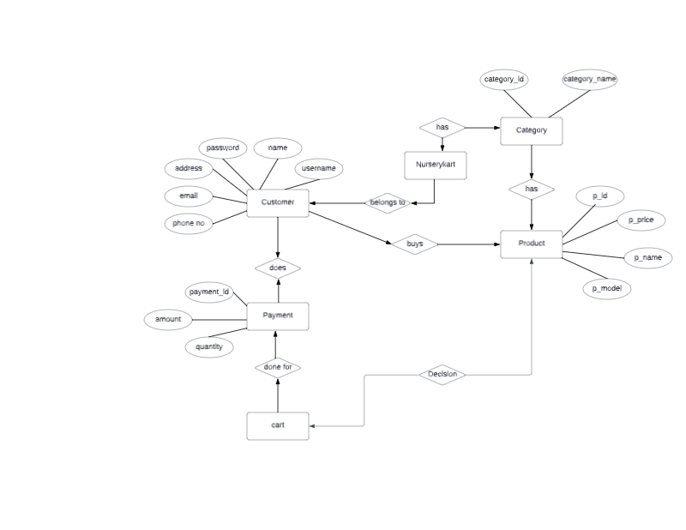
Flow chart
NurseryKart

Slide 9
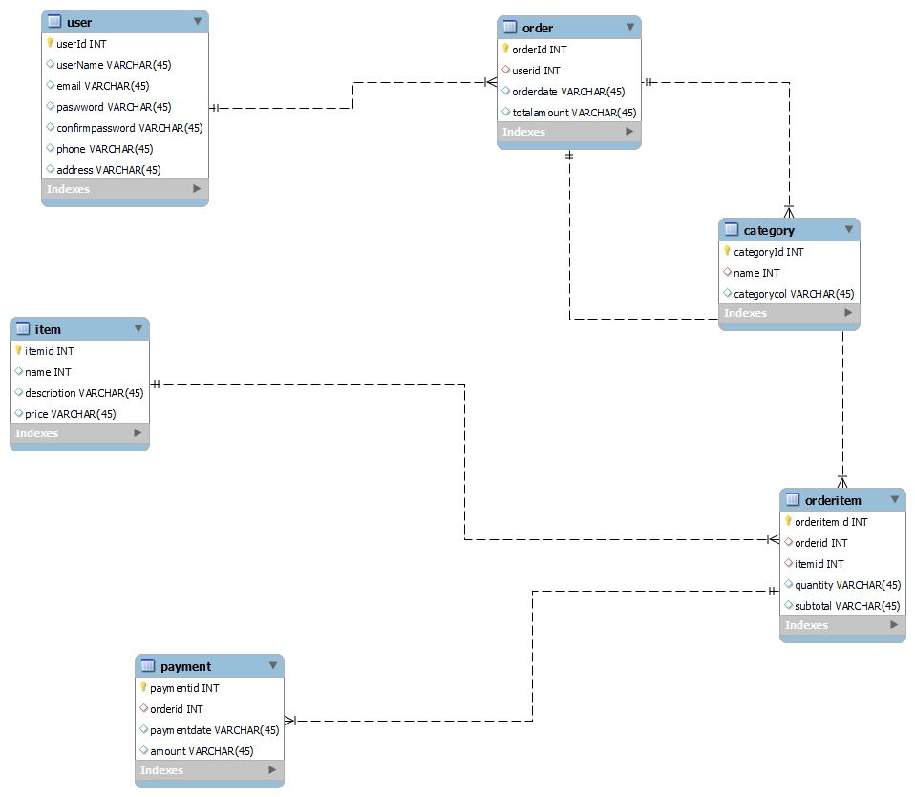
Er diagram
NurseryKart

Slide 10
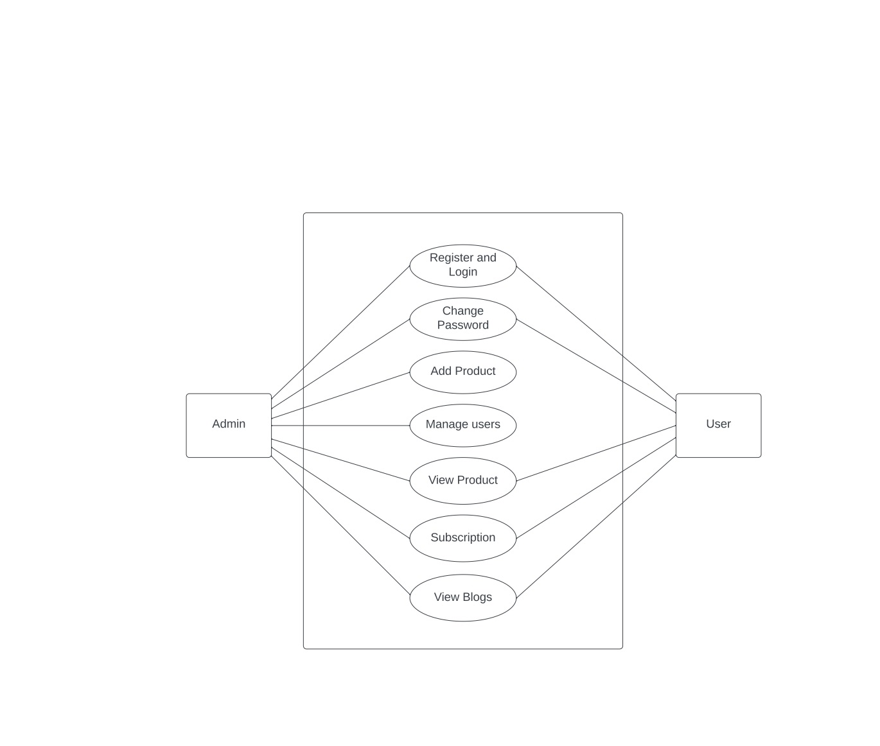
DATA FLOW DIAGRAM
NurseryKart

Slide 11
TECHNOLOGY USED
NurseryKart
Front-End: HTML5, CSS3, Bootstrap5, JavaScript.
Back-End: Spring Boot, Hibernate
Database: MYSQL Workbench

Slide 12
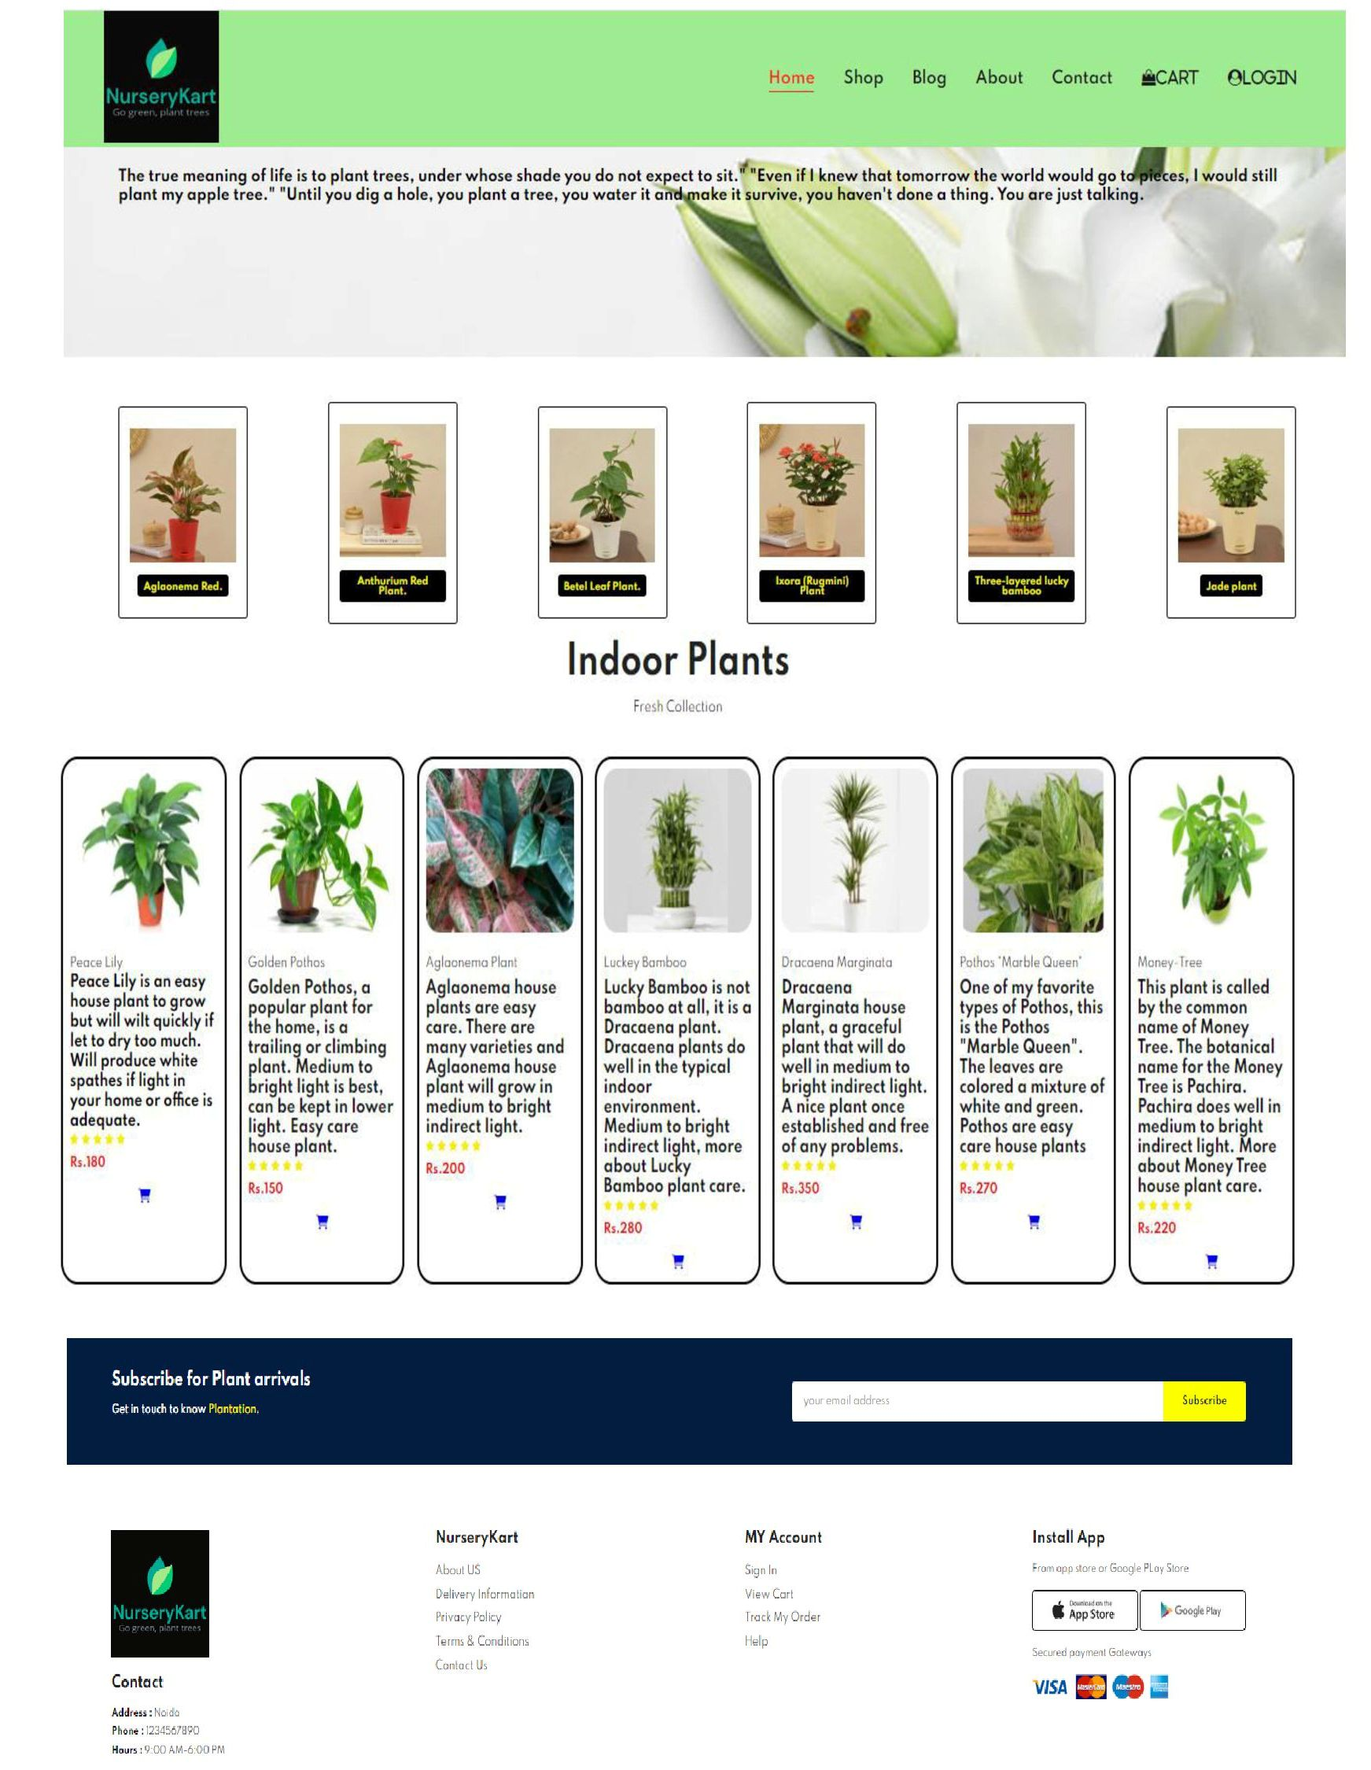
HOME PAGE
NurseryKart

Slide 13
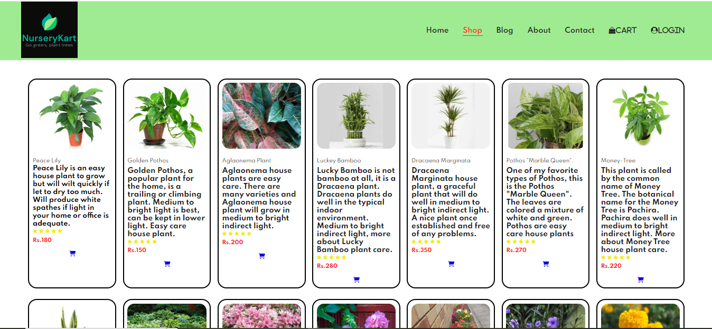
SHOP PAGE
NurseryKart

Slide 14
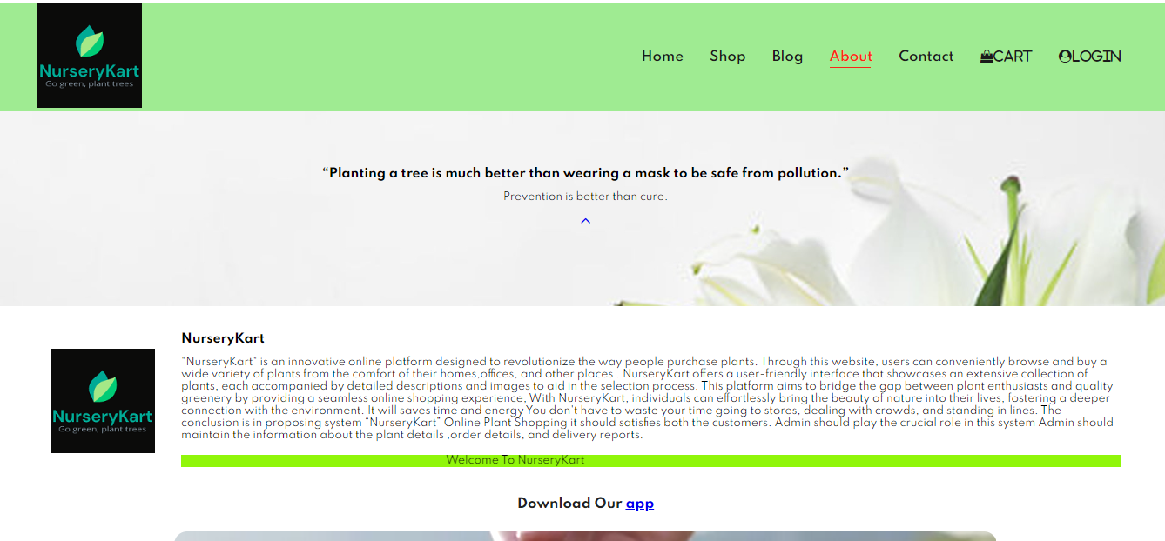
ABOUT PAGE
NurseryKart

Slide 15
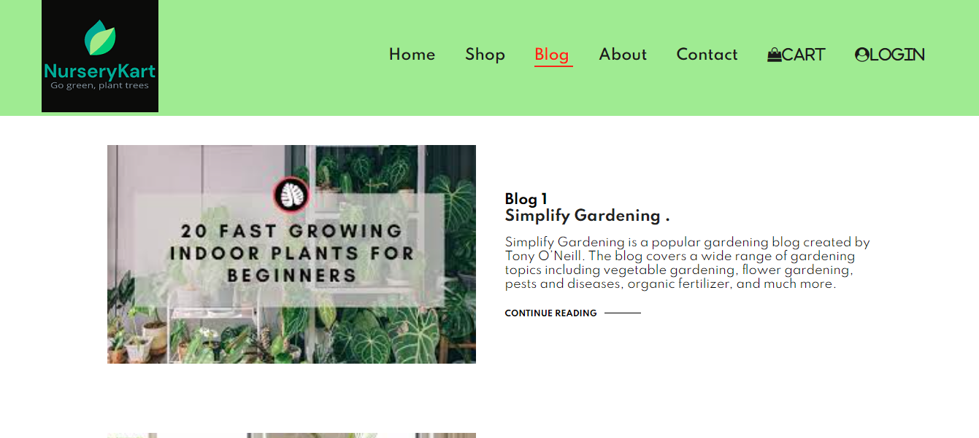
BLOG PAGE
NurseryKart

Slide 16
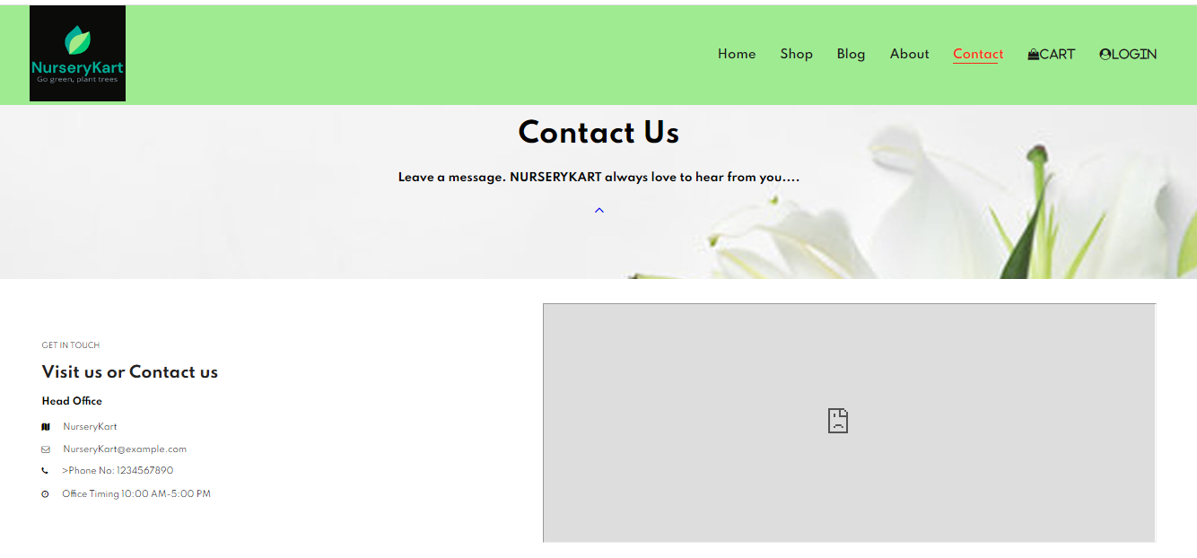
CONTACT PAGE
NurseryKart

Slide 17
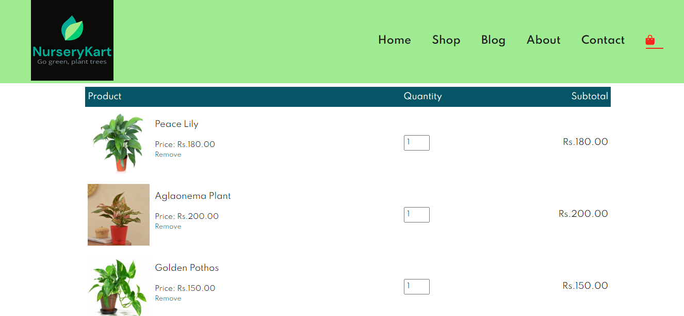
CART PAGE
NurseryKart

Slide 18
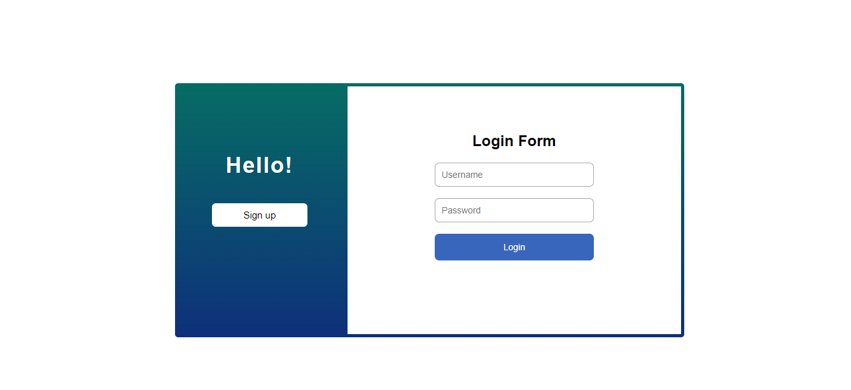
LOGIN PAGE
NurseryKart

Slide 19
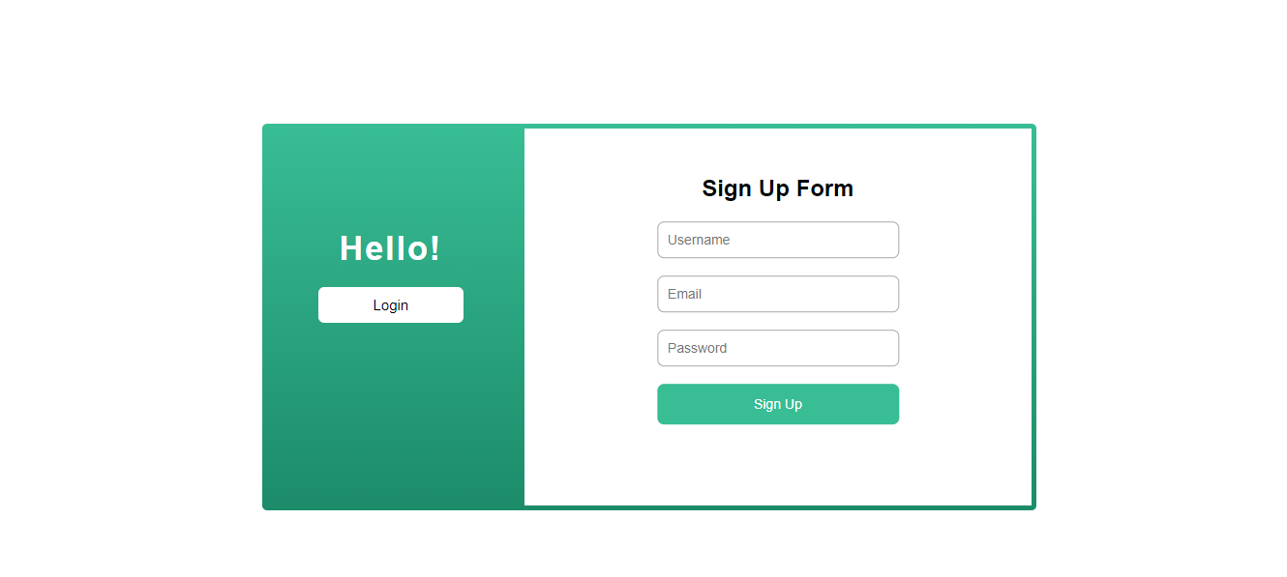
SIGN-UP PAGE
NurseryKart

Slide 20
CONCLUSION:
The conclusion is in proposing system “Nurserykart” Online Plant Shopping it should satisfies both the customers. Admin should play the crucial role in this system Admin should maintain the information about the plant details ,order details, and delivery reports.
Working on this project was fun and insightful at the same time as we got to learn a lot of things.

Slide 21
THANK YOU !

